Slide 1
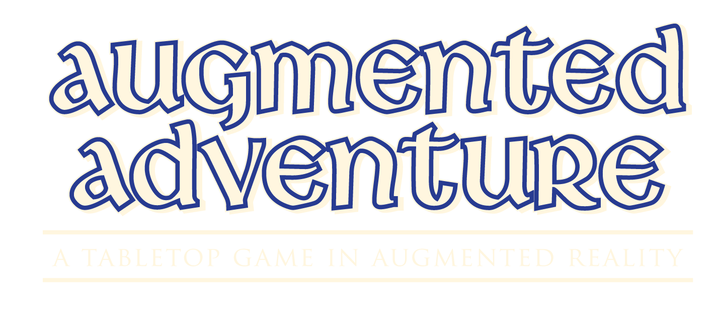

Slide 3
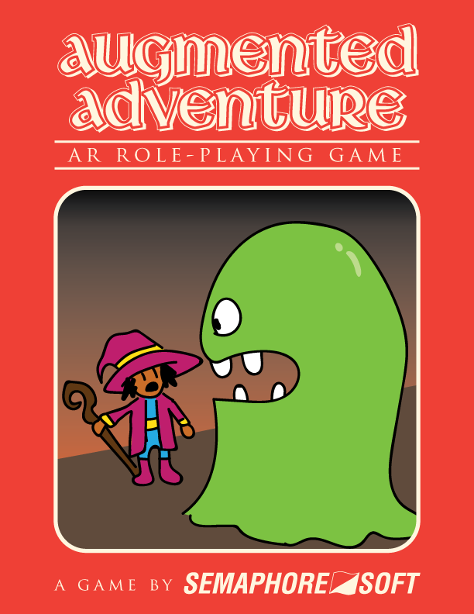
Overview
Mobile App for Android Systems
Multiplayer Role Playing Game in
Augmented Reality
One to four players
Artstyle inspired by early 3D games

Slide 4
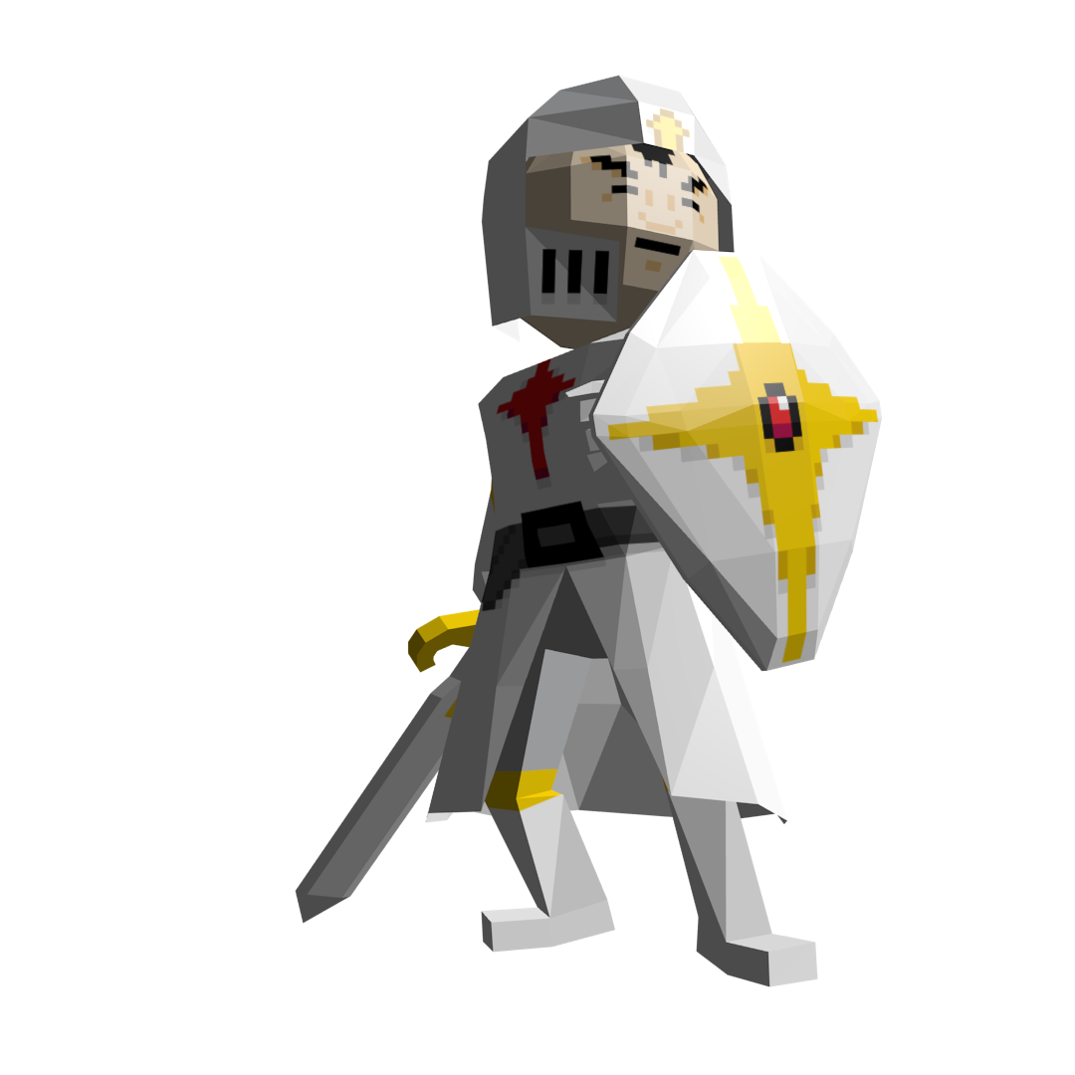
Inspiration
D&D Map Maker
RPG App
Dungeons and Dragons
Betrayal at the House on the Hill
Earthbound

Slide 5
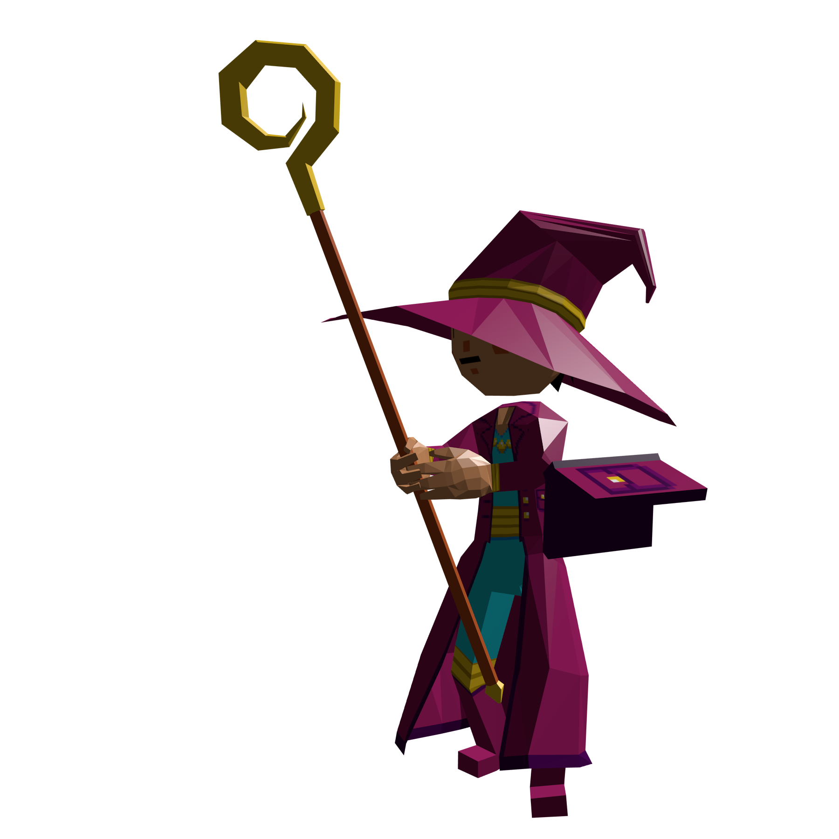
Building a World
Players
Dungeon Building
Enemy Behavior
Gameplay

Slide 6

Players
Waypoint Marker
Room Association
Dungeon Traversal
Must Attack/Defend/Use Item/Special to End Turn

Slide 7
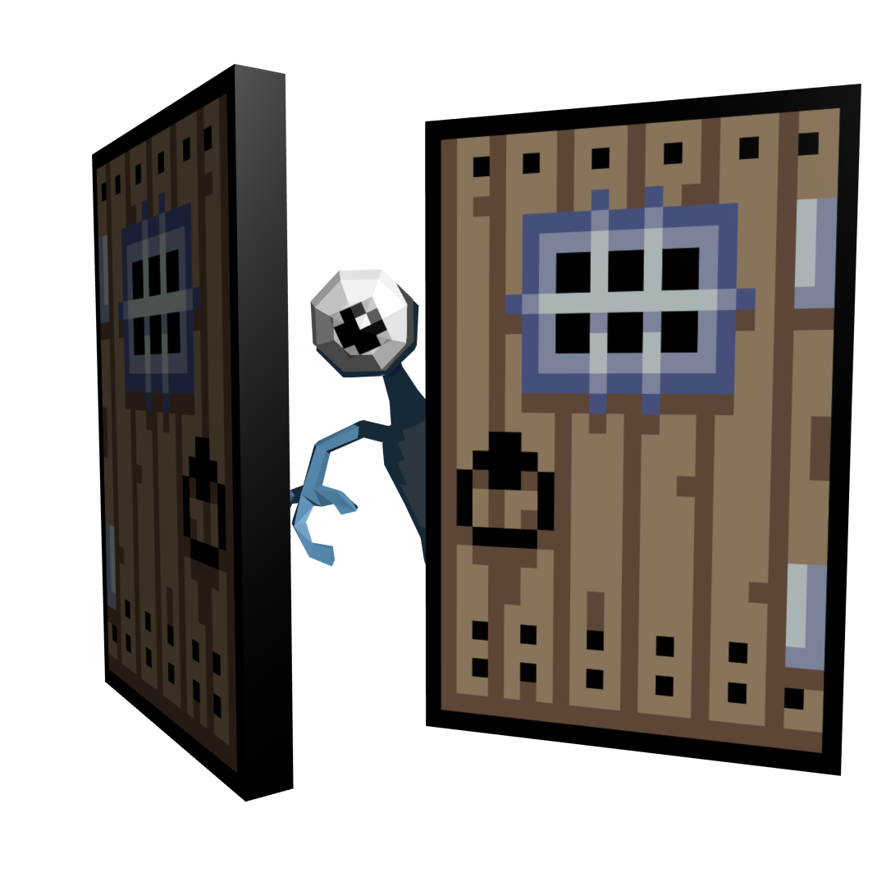
Dungeon Rooms
Attached to a Marker
Connected by Doors
Square Grid
Valid Adjacency
Unlimited Accommodation of Players and Enemies

Slide 8
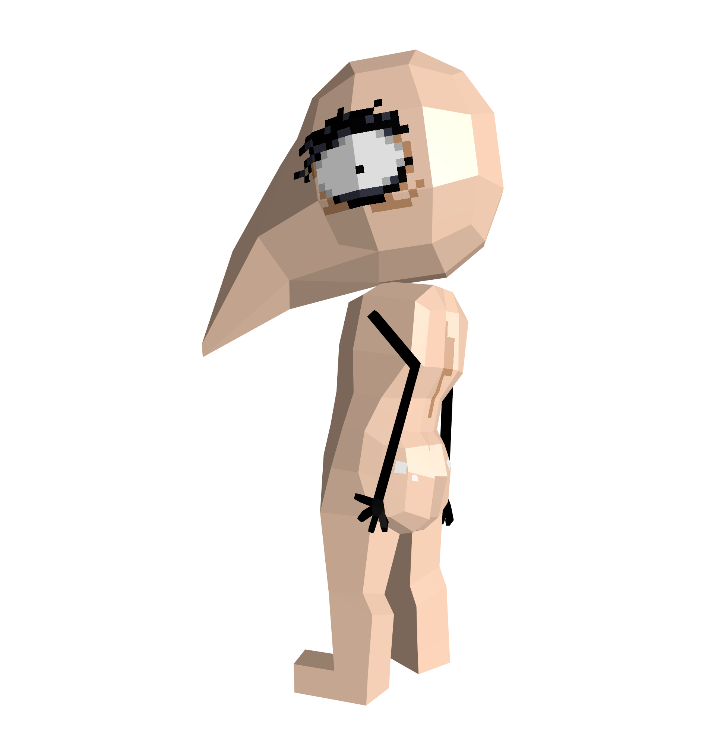
Enemies
These are the bad guys!
Generate in Rooms
Take Turns like Players
Different Enemies have Different Behaviors
May drop items upon defeat

Slide 9
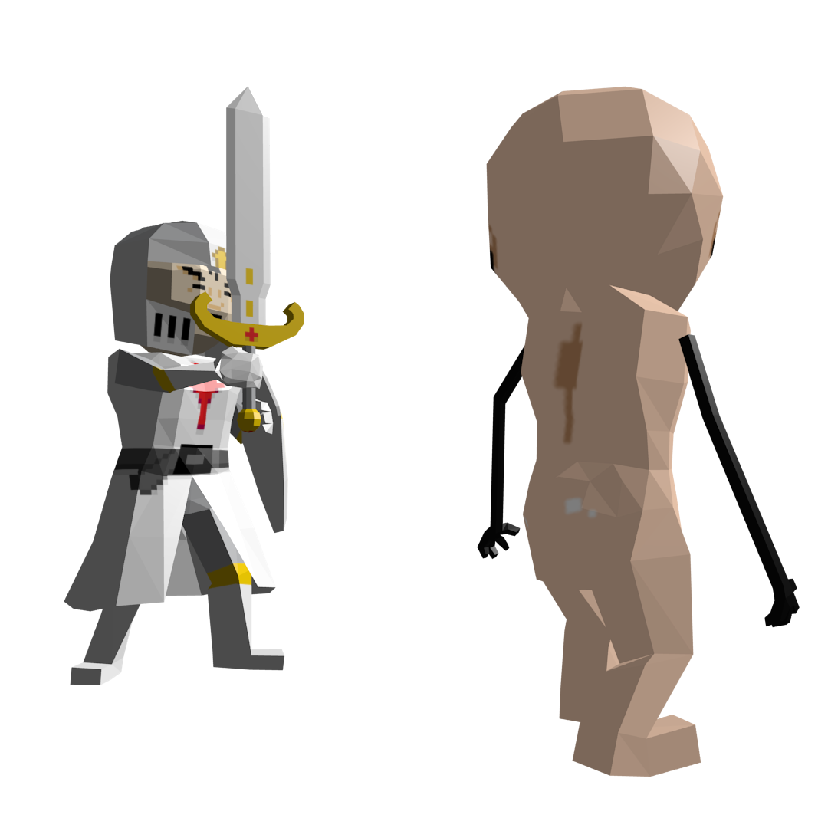
Game Flow
Player Marker Selection
Start Room Generation
Open Doors - Place Additional Rooms
Take Turns Moving and Acting
Fight Encountered Enemies
Continue Until Boss Encounter

Slide 10
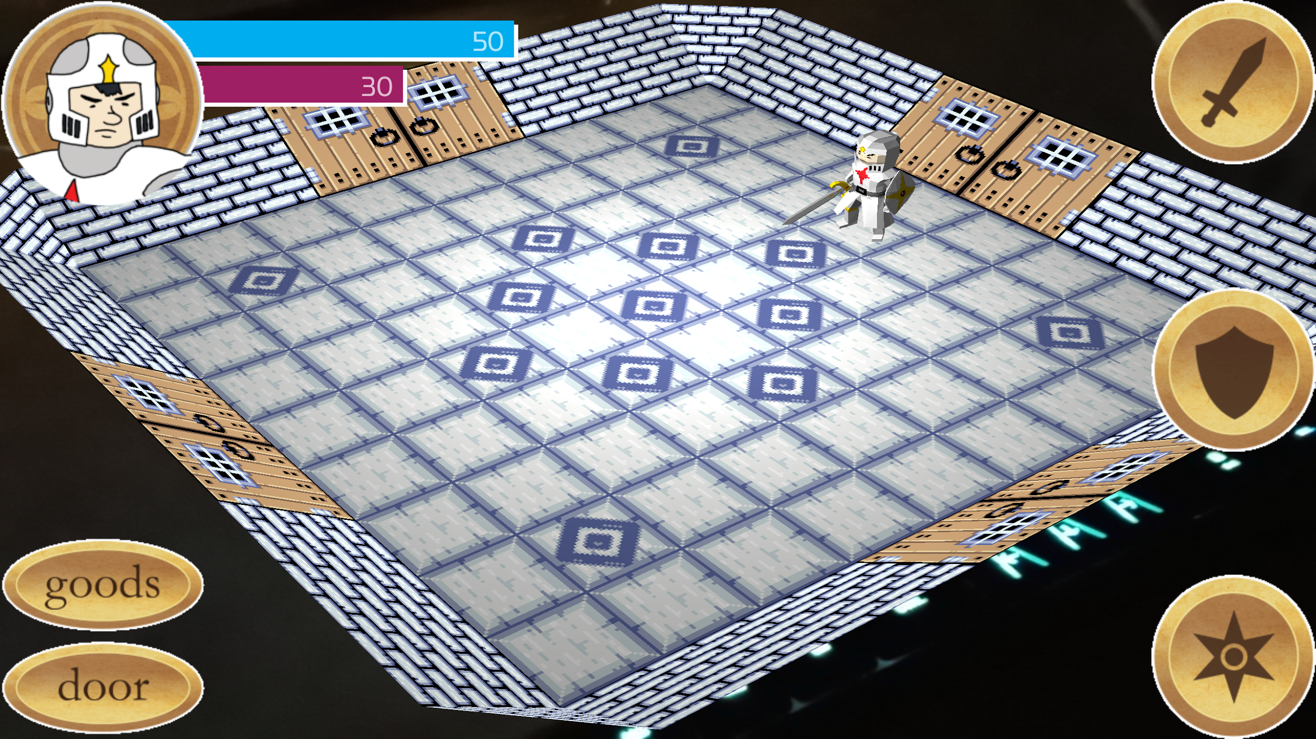
User Interface
Interactive Elements Overlaid on Camera Feed
Goal: Clean Interface, Easy-to-Use and Attractive
Minimize Button Clicks for
Hassle-Free Navigation
Minimal UI to Maximize Feed Area

Slide 11
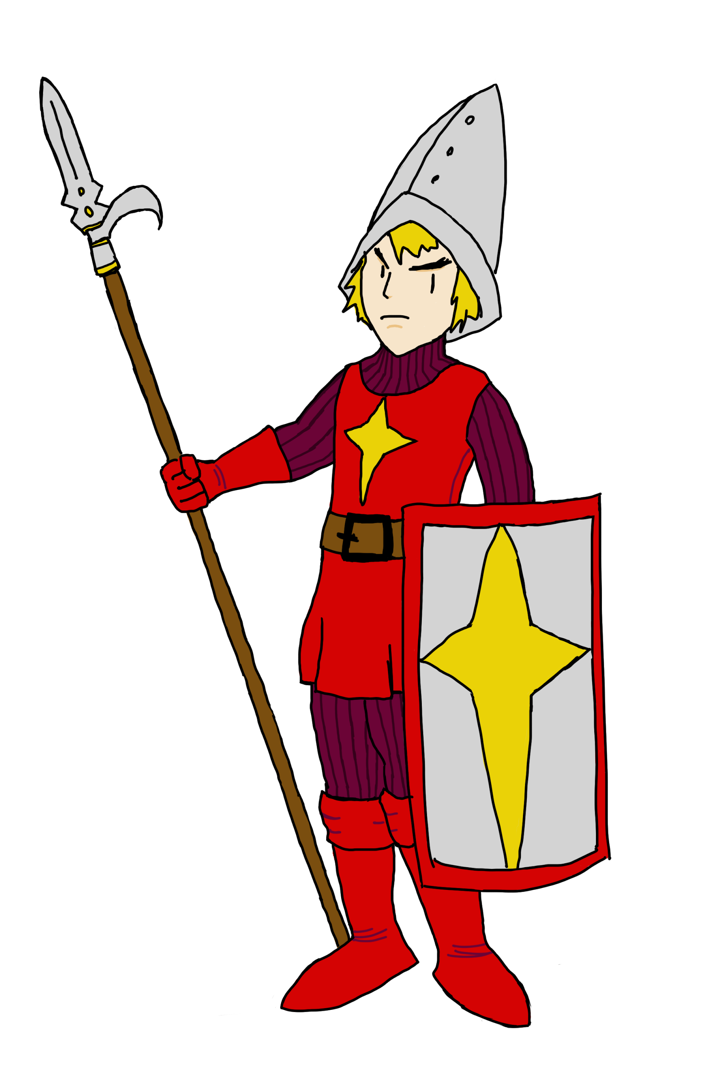
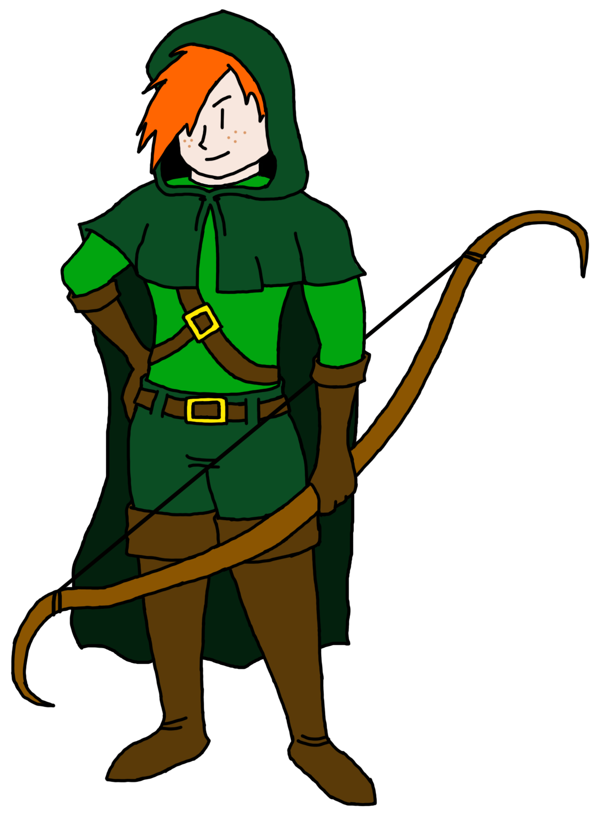
The Art of War - 2D edition
Concept art drawn in Photoshop or by hand
Textures made in Microsoft Paint
Character design influenced by 16-bit
role playing games

Slide 12
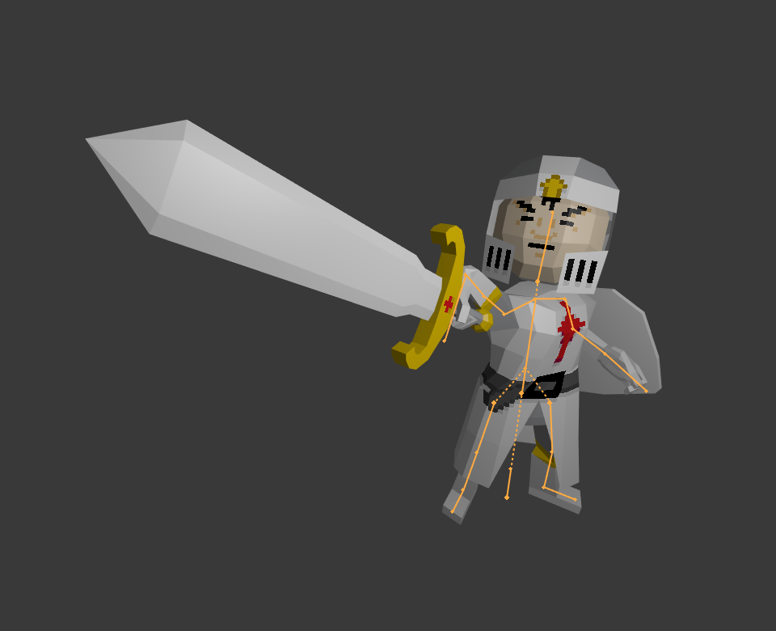
The Art of War - 3D Edition
Done in Blender
Modeling low-poly
Pose to pose, not animated

Slide 13


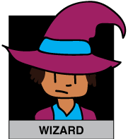

2’s Company, 3’s a Crowd, and 4’s a Party
Networking
Connects over WiFi
Send messages to all or a specific client

Slide 14
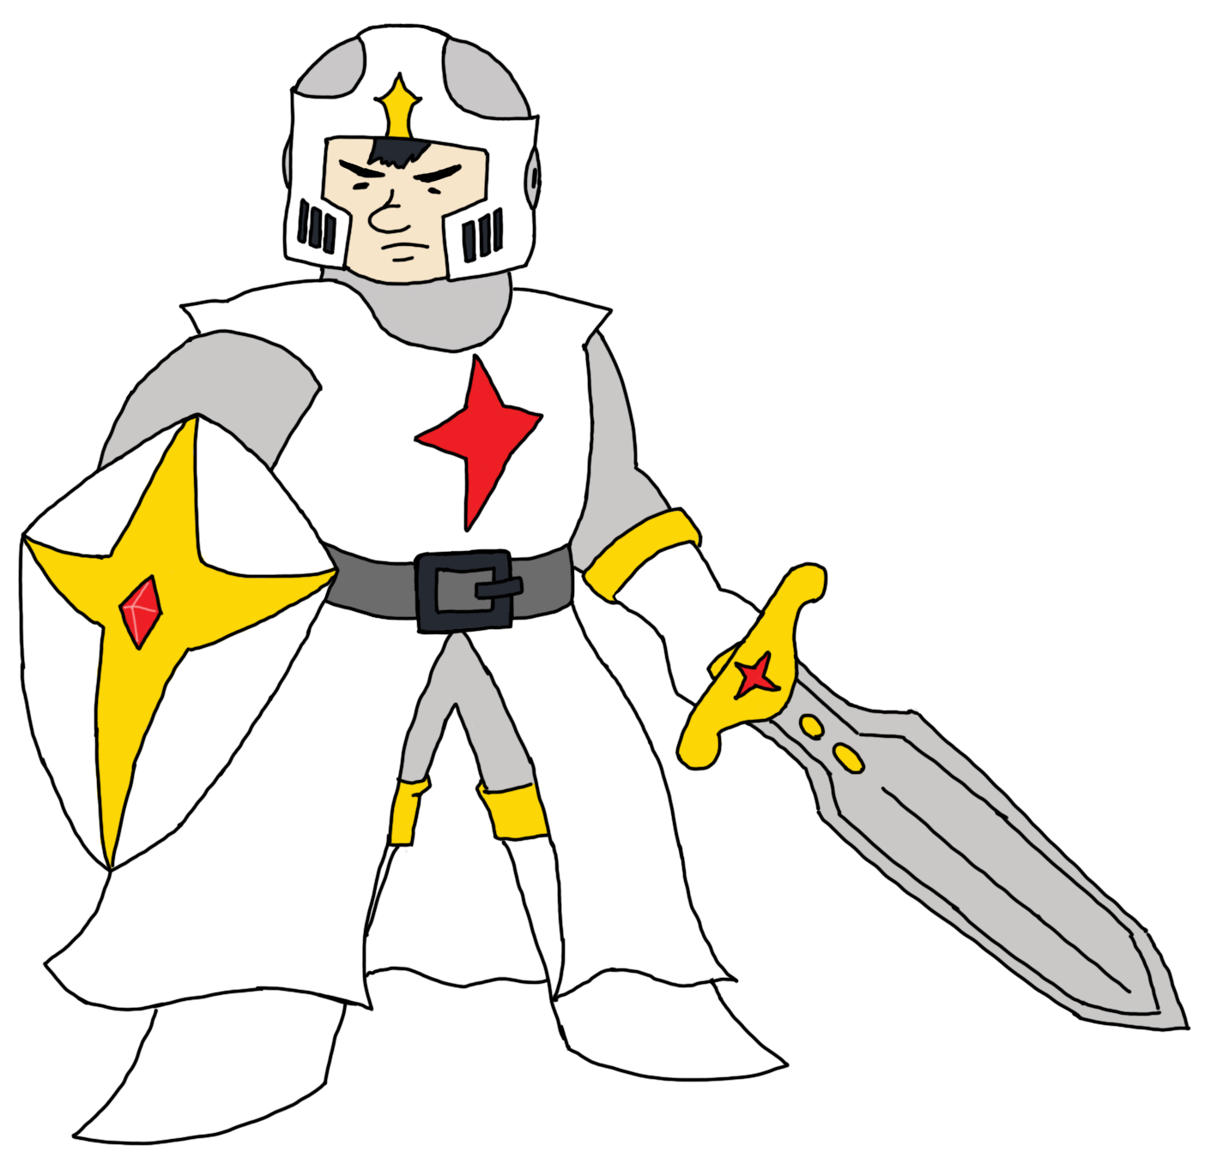
Host-Client Relationship
Host manages all gamestate data
Client sends requests to be validated by the host

Slide 15
Network Services
Use BoundServices to communicate with network threads
Allows the same network connection to be used in multiple activities
More control over service lifecycle

Slide 16
Program Design
Modularity - Easily Interchangeable Assets
XML Files
Fault Tolerance

Slide 17

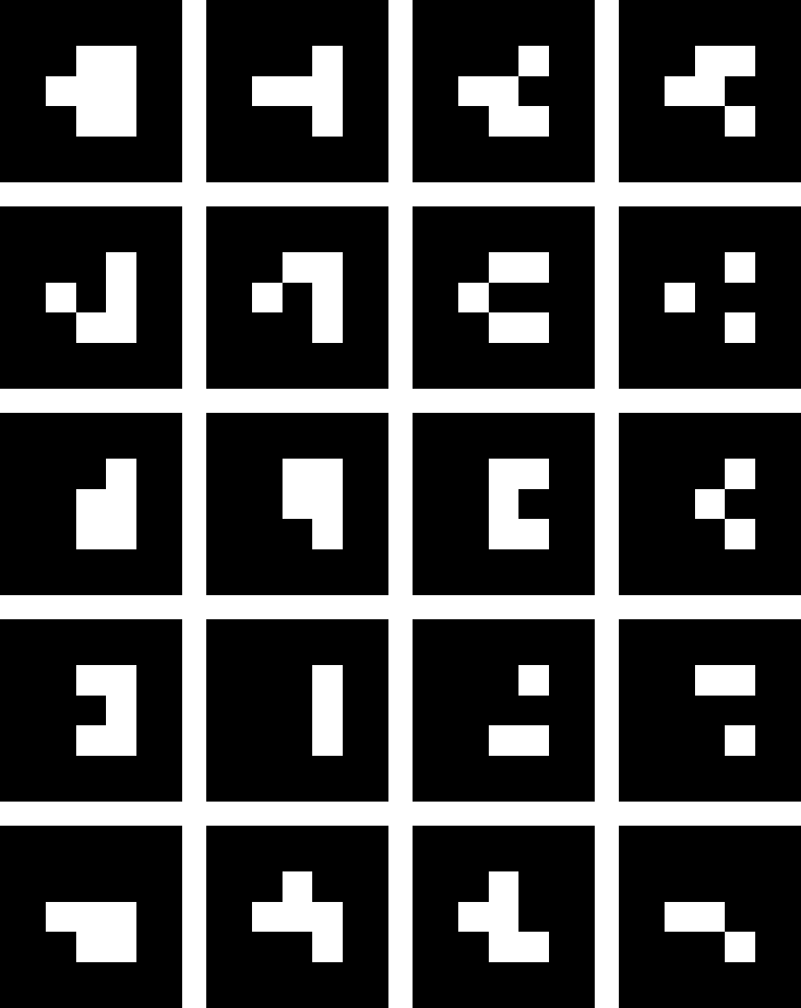
Camera Feed
Marker Detection
Transformation Matrix

Slide 18

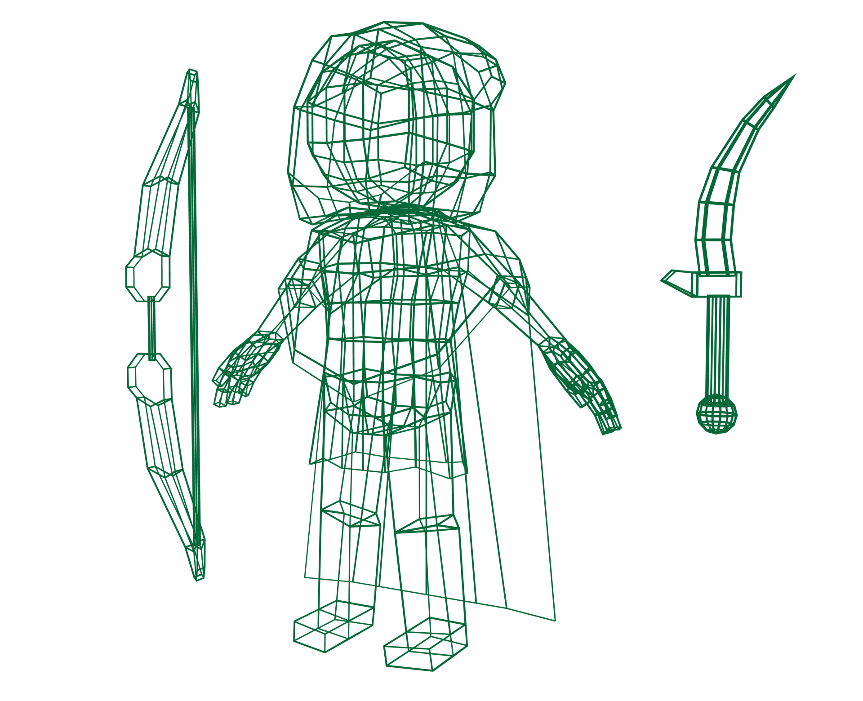
OBJ Files
Indexed (Vertex) Buffer Objects
Transformation Matrix
GLSL Shaders

Slide 20
Special Thanks
Kenneth Madsen and Kenneth McClure - Matrix Manipulation and Math Advice
Alex Fox - Additional Playtesting
James Ward - Inspiration
Kevin MacLeod - Music (“Overworld”)

Slide 21
Q
A
&

